Slide 1
Customer Retention
Name: Zalak Maru

Slide 2
Content
PROBLEM DEFINITION
DATA PROCESSING
DATA ANALYSIS
CHARTS AND GRAPHS
CONCLUSION

Slide 3
Problem Definition
According to this public survey, Customer satisfaction is an important factor for stores to increase purchase.
Some supporting factor are based on site interface, trust and company’s performance ie. Product quality, delivery, benefits and security policies.
Research includes factors such as reason for repeat purchase and how loyalty factors influence customers activities.
Survey is based on 5 online stores: Amazon, Flipkart, Myntra, Snapdeal and Paytm.
We have performed extensive analysis on dataset for customer activation and retention.
Customer Retention study is necessary for understanding activities required for reducing the number of customer defections.
The goal of customer retention programs is to help companies retain as many customers as possible, often through customer loyalty and brand loyalty initiatives.

Slide 4
Data Processing
Dataset is imported in csv format.
This dataset is composed from survey hence, data is not in usable format. The data is still raw and needs proper Data Cleaning and Transformation.
We need to obtain Site rating, Service rating, customer rating, Time spent by users on each platform, % of users using the platform, % of users recommending the platform for each platform, order cancellation possibility, Drawbacks of the platform, Success rate of user recommending the platform after used, % of potential risk, % of users recommending the platform after using the platform for longest time & % of users recommending the platform after being the most frequent buyer of the platform.
Usage is a major factor which compares the customers retention rate.
Lastly, if a user has used all the platforms then what are his views and recommendations regarding the platforms.

Slide 5
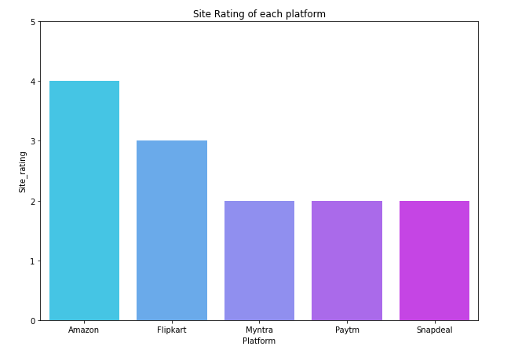
DATA Analysis
This chart represents site ratings of each platform.
The rating for Amazon is highest.
The higher the rating, better the chances of retaining customers, new and existing. Amazon stands with an outstanding rating 4/5
Flipkart next in line having rating 3/5.
Meanwhile the others have very lower chances of customer activation and higher chances of existing customers leaving based on the rating of their site.

Slide 6
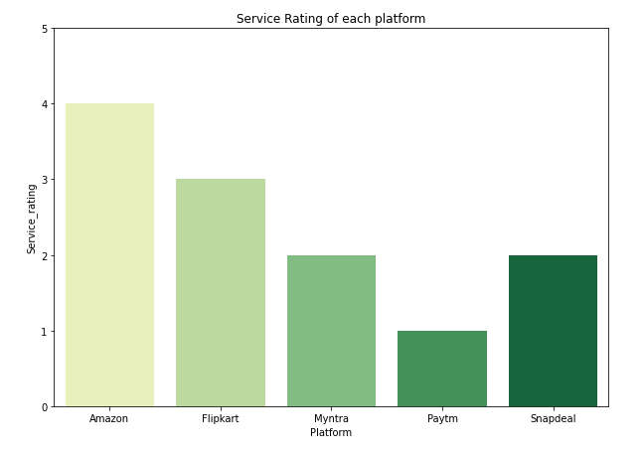
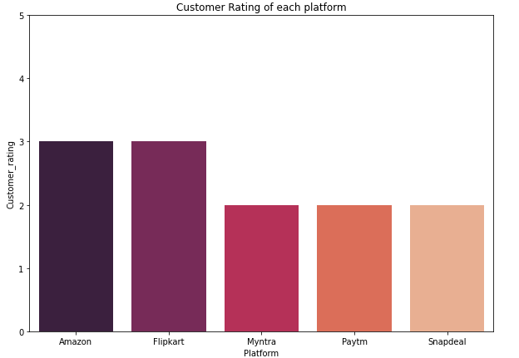
CHARTS AND GRAPHS
Customer Rating chart represents customer satisfaction based on service provided.
Amazon and Flipkart have 3/5 rating which is highest among all.
Highest rating explains customer will prefer shopping based on past experience.
Service rating for each platform is based on load time, speed of web and delivery, etc.
This chart explains highest rating for Amazon followed by Flipkart.

Slide 7
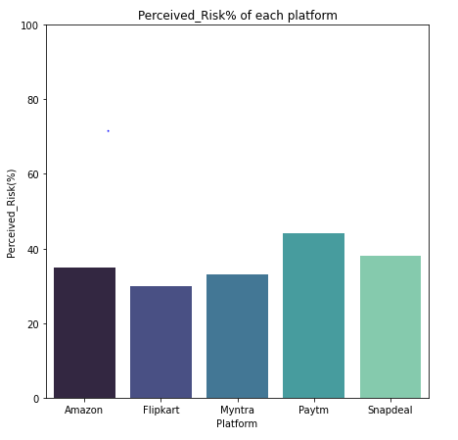
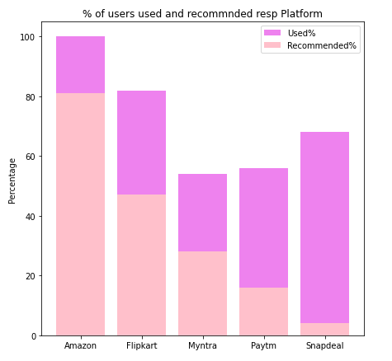
CHARTS AND GRAPHS
Perceived Risk explains the higher the risk%, the lower the chances of retaining an existing user.
If the risk% is of very value platform can start loose existing customers
Flipkart has the lowest risk% among all of the platforms. Myntra being the second lowest and amazon third lowest.
Amazon has highest used and recommended by customers.
Flipkart being next in line with high user percent and recommendations.
Recommendation is a sign of users interest in this platform, the higher, the more activation and retention

Slide 8
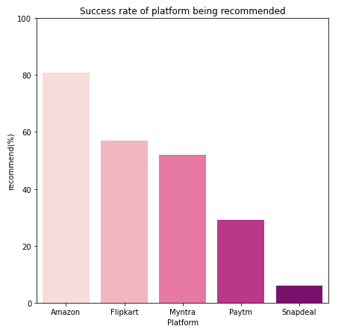
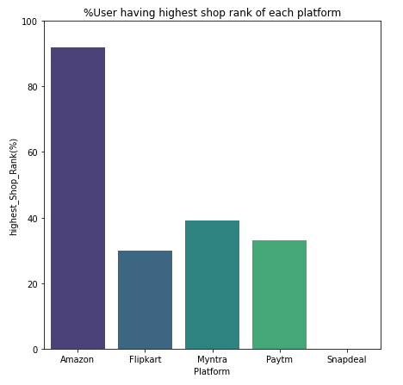
CHARTS AND GRAPHS
Success rate is obtained by getting the percentage of users The higher the Success rate%, the higher the chances of retaining an existing user .
Amazon, Flipkart and Myntra have more than 50% success rate and hence the chances of customer activation and retention is higher in these platforms.
Out of the users which recommended this platform, what % of the users have highest shop rank.
The higher the elite rank, the higher the chances of retaining an user.
Amazon has an outstanding number of highest shop rank users.

Slide 9
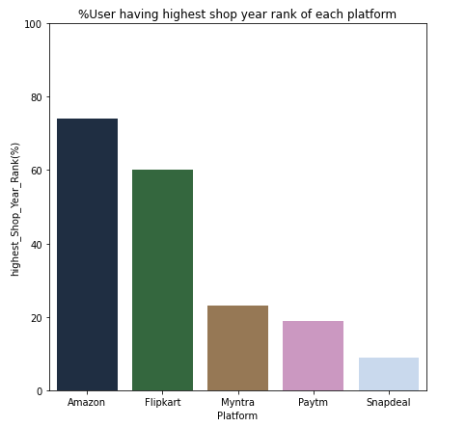
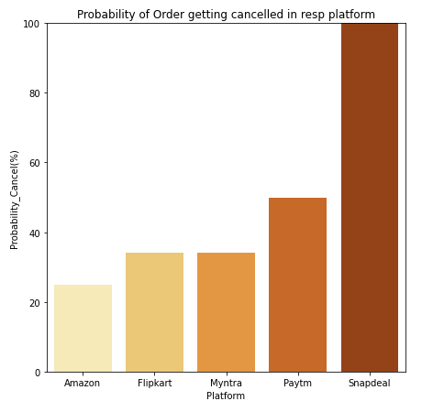
CHARTS AND GRAPHS
The higher the elite rank%, the higher the chances of retaining an existing user.
Amazon & Flipkart has an outstanding number of highest shop year rank users, the chances for activation and retention of customer is very high.
Rest don’t even have 50% of such group in them.
Amazon has the lowest cancel rate, then Flipkart and Myntra, rest all have more than 50% cancel rate and hence the chances of customer retention is lowest in these platforms
The lower the cancel rate the better for company

Slide 10
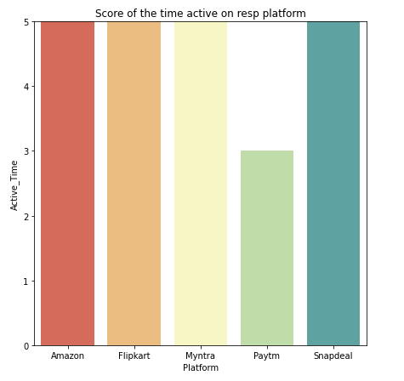
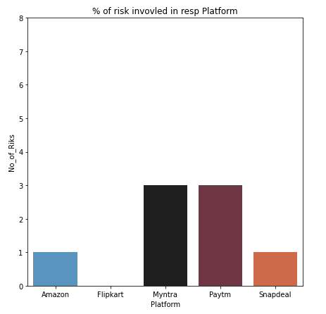
CHARTS AND GRAPHS
This graph gives us the number of drawbacks a platform has.
The more the drawbacks the lower the chances of activation and retention of the customer.
Flipkart being the one with no drawbacks and then Amazon and Snapdeal with one drawback
The lesser the drawbacks, the better.
This graph gives us the number of drawbacks a platform has.
The more the drawbacks the lower the chances of activation and retention of the customer. The lesser the drawbacks, the better.
Flipkart being the one with no drawbacks and then Amazon and Snapdeal with one drawback
Customer activation & Retention is inversely proportional to this number.

Slide 11
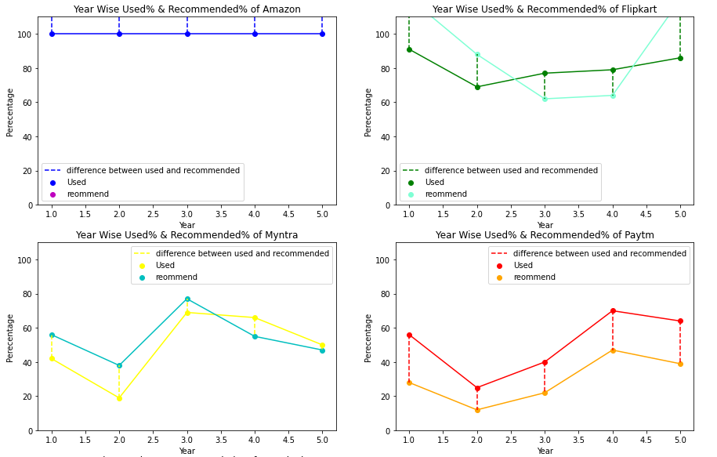
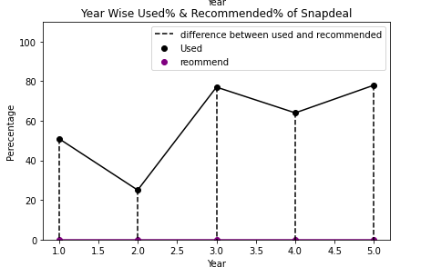
CHARTS AND GRAPHS
From above we can deduce that the users recommended for amazon is higher than the used. Hence the user activation of amazon is higher than any other platform.
To check retention we shall check the used and recommended % of every platform of year rank1 and year rank 5.
Our goal should be to reduce the gap between the used and recommended of every platform

Slide 12
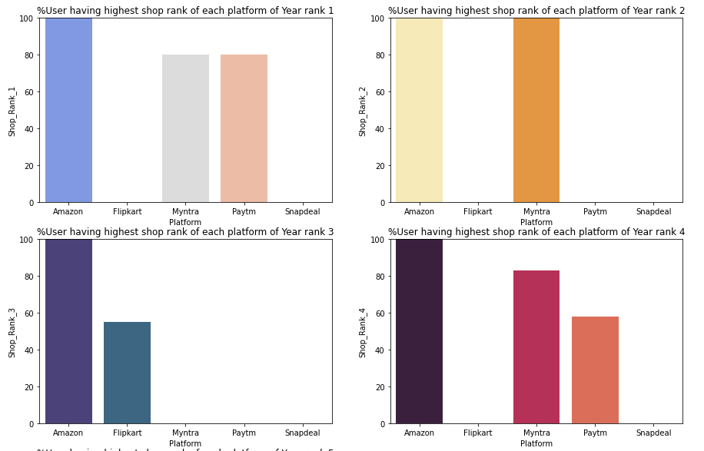
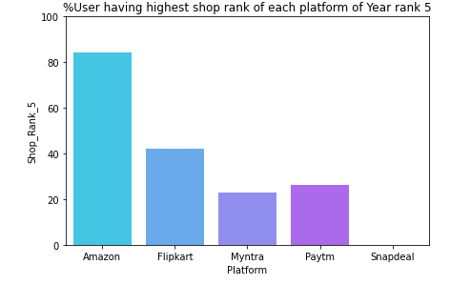
CHARTS AND GRAPHS

Slide 13
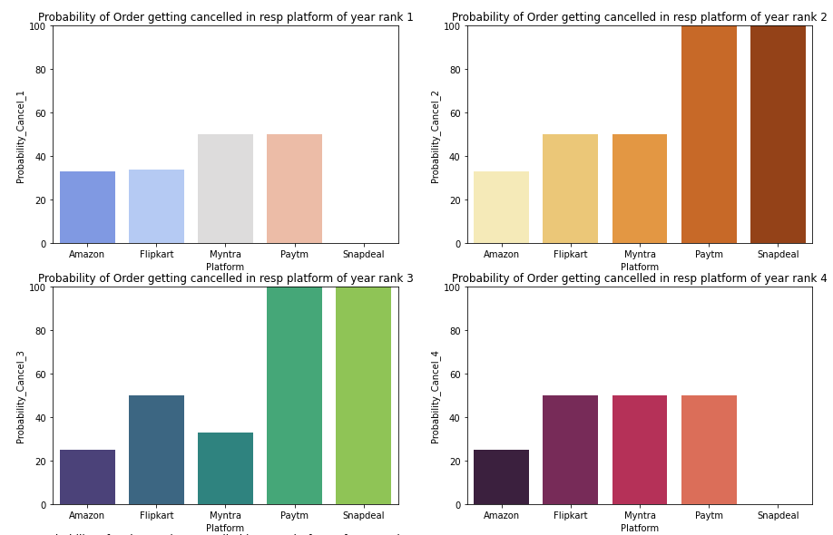
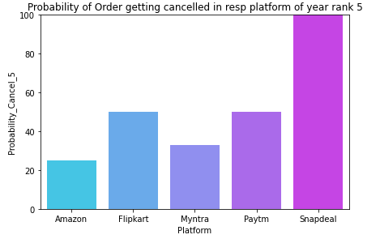
CHARTS AND GRAPHS

Slide 14
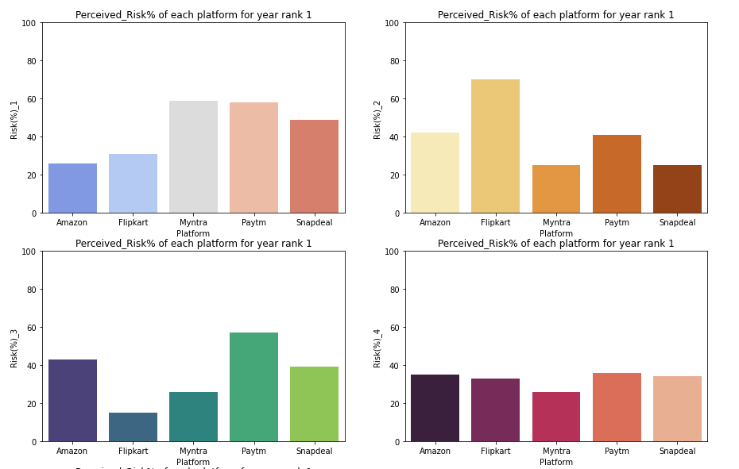
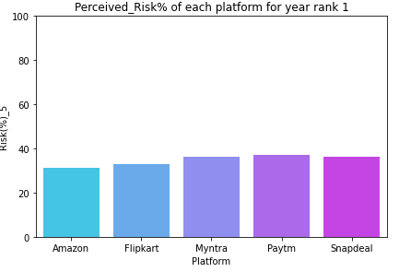
CHARTS AND GRAPHS

Slide 15
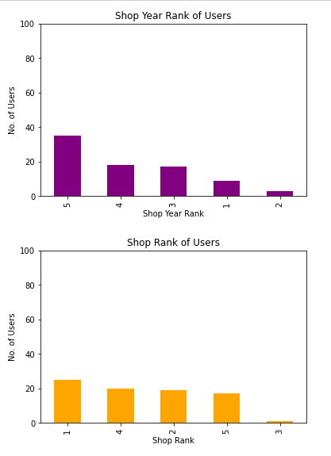
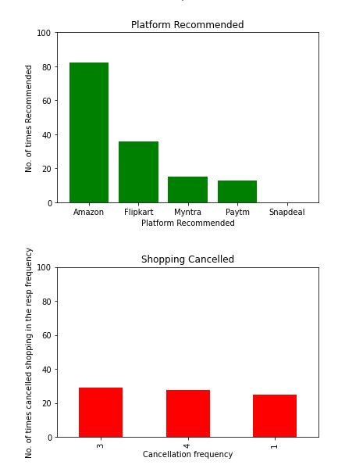
CHARTS AND GRAPHS
The graph is to display shop year rank for a user who has used all the platforms available.
Shop year rank of highest rank is attained when all platforms are used.
The graph is to display shop rank for a user who has used all the platforms available.
Lower shop rank is obtained when a user uses all platform.
We can see that when user has used all the platform he is never recommending Snapdeal.
Amazon & Flipkart are most recommended.
When a User uses all the platform his cancellation frequency also decreases.
Good chance of an order never being cancelled or being cancelled very few times.
In comparison to the combination of never and sometimes cancellation frequency, frequent shopping cancellation is less.

Slide 16
Conclusion
Amazon and Flipkart are most used and recommended platforms.
These platforms have higher rating in every terms.
These platforms have lower risk%, lesser drawbacks and less cancellation chances of an order.
These platforms have high percentage of elite group with good credibility using and recommending the platform.
Out of these 2, Amazon is the one which has higher chances of customer activation and recommendation.
Rest all platforms should be improved or their existing users are going their platforms.

